Slide 1
Our new reading scheme

Slide 2
Why are we changing our reading scheme?
The national curriculum says:
Skilled word reading involves both the speedy working out of the pronunciation of unfamiliar printed words (decoding) and the speedy recognition of familiar printed words. Underpinning both is the understanding that the letters on the page represent the sounds in spoken words. This is why phonics should be emphasised in the early teaching of reading to beginners (i.e. unskilled readers) when they start school.
This is why we have decided to introduce phonics reading books into our new reading scheme.

Slide 3
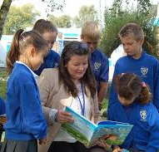
What will it look like?
Our current books have been thoroughly sorted through and we have also added new titles.
They have all be re-banded meaning that ALL books from different schemes are now in a coherent system.
The children will still be able to choose the book they like to promote a love for reading.
The bands will be in colours rather than levels starting at lilac all the way through to silver (free reading).

Slide 5
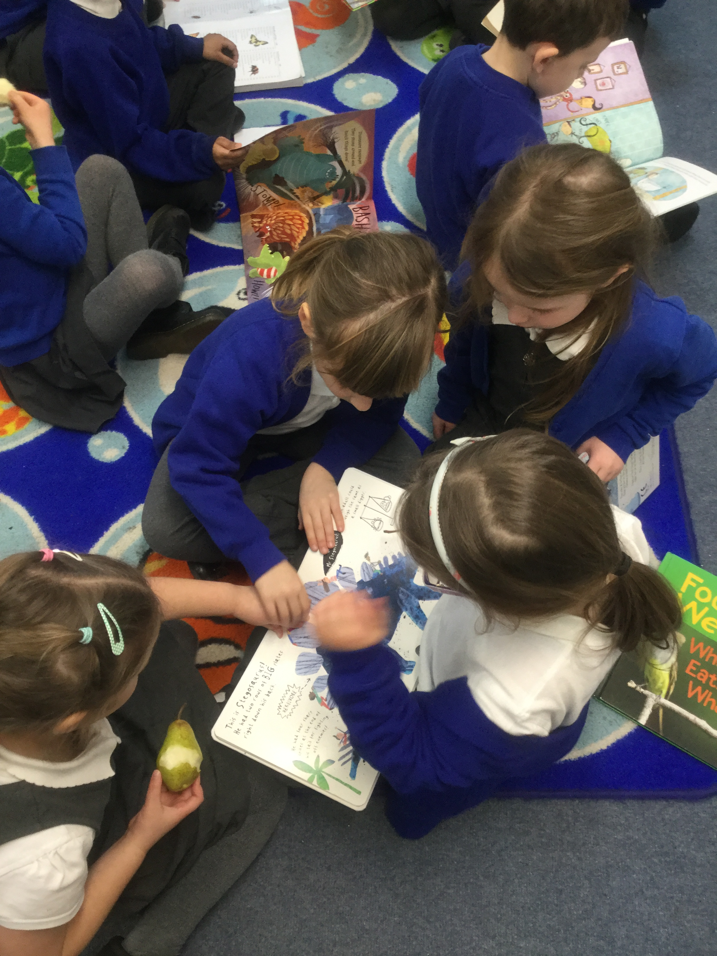
What about the phonics books?
The phonics books will be in addition to our regular scheme. These books, unlike the reading books given, will be fully decodable and inline with the phonics that they are being taught in school.
For example:
Each book will be focusing on a particular sound that they have studied that week or term and will reinforce that learning. The children should find these books ‘easier’ to read as the sounds are tailored to their phonic phase they are on. By having books that are at their phonetical level children should improve their fluency and thus confidence in reading.

Slide 6
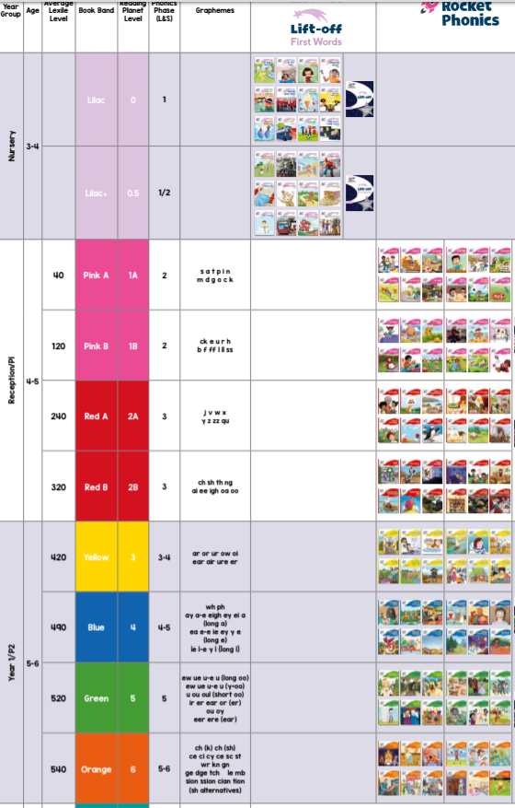

Slide 7
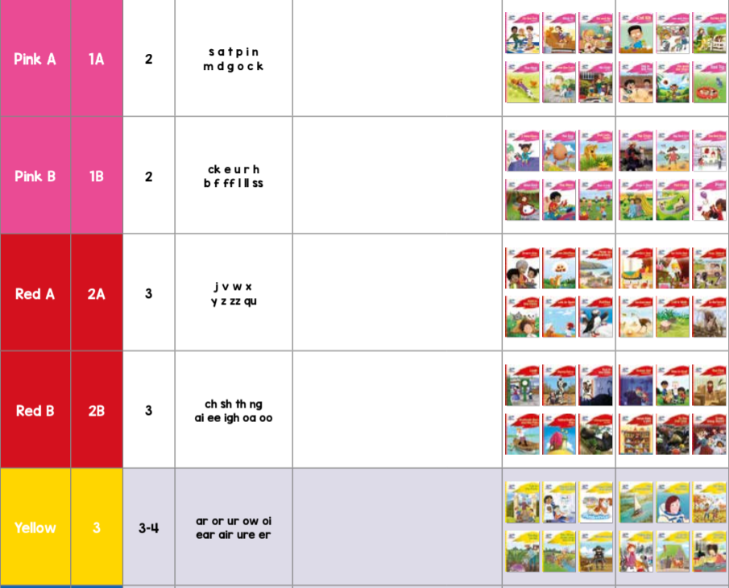

Slide 8
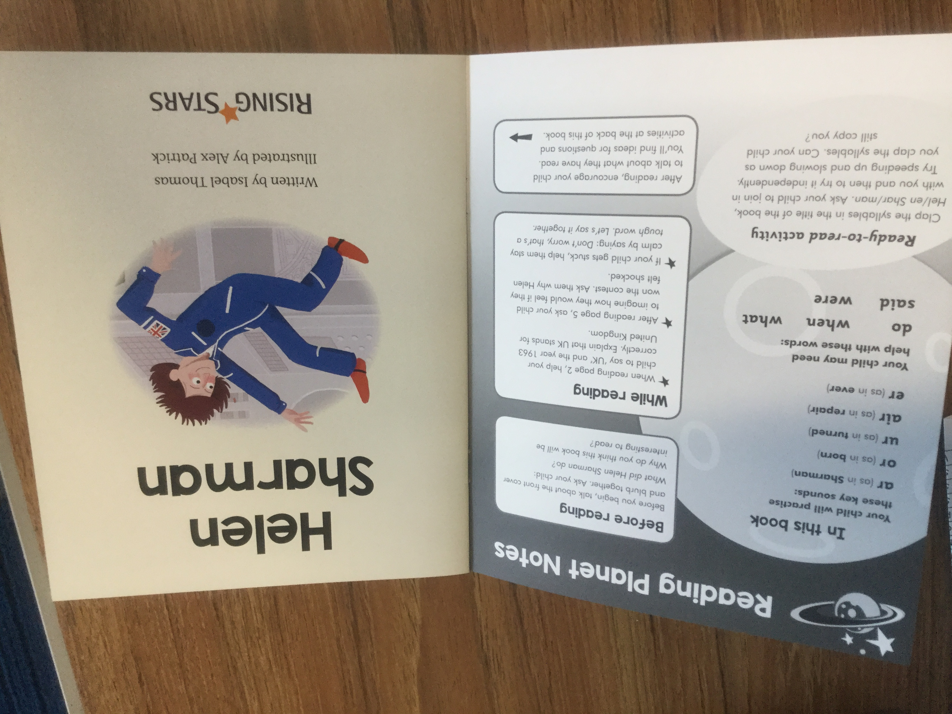
Key features of our new phonic books
Key words and sounds
Key information about the text and how to support your child.
Fun activities to extend their learning.

Slide 9
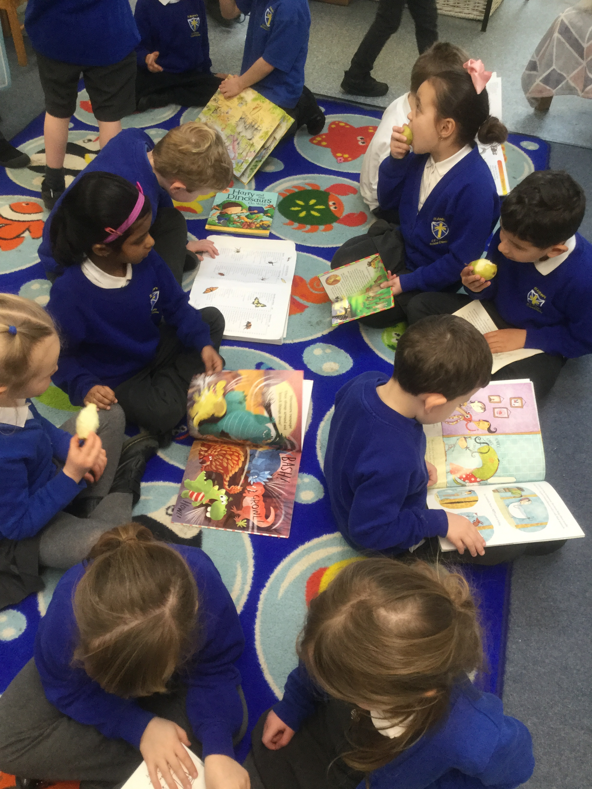
Important things to note!
It is important to note that if a child is on a blue band for their reading book they will not necessarily be on a blue band for their phonics book.
If a child is on turquoise reading scheme or above they will not be receiving a phonics book this is because they are able fluently read and have learned all or most of the new graphemes taught.
The books have been re-banded meaning that the levels of the books have been checked and placed in a different order. The children have also been re-banded and now have a new colour not level.
This is a universal way of banding existing books across multiple existing schemes.
SO PLEASE DO NOT WORRY IF YOUR CHILD HAS GONE ‘DOWN’ A LEVEL.
We review children’s reading bands and will continue to do so especially during this time of change with our reading scheme.

Slide 10
The new library
Our new library is where we will have group intervention sessions including Mrs Clissold’s phonics groups.
It is also an area for quiet reading and whole class reading sessions.

Slide 11
Any questions?

